Slide 1
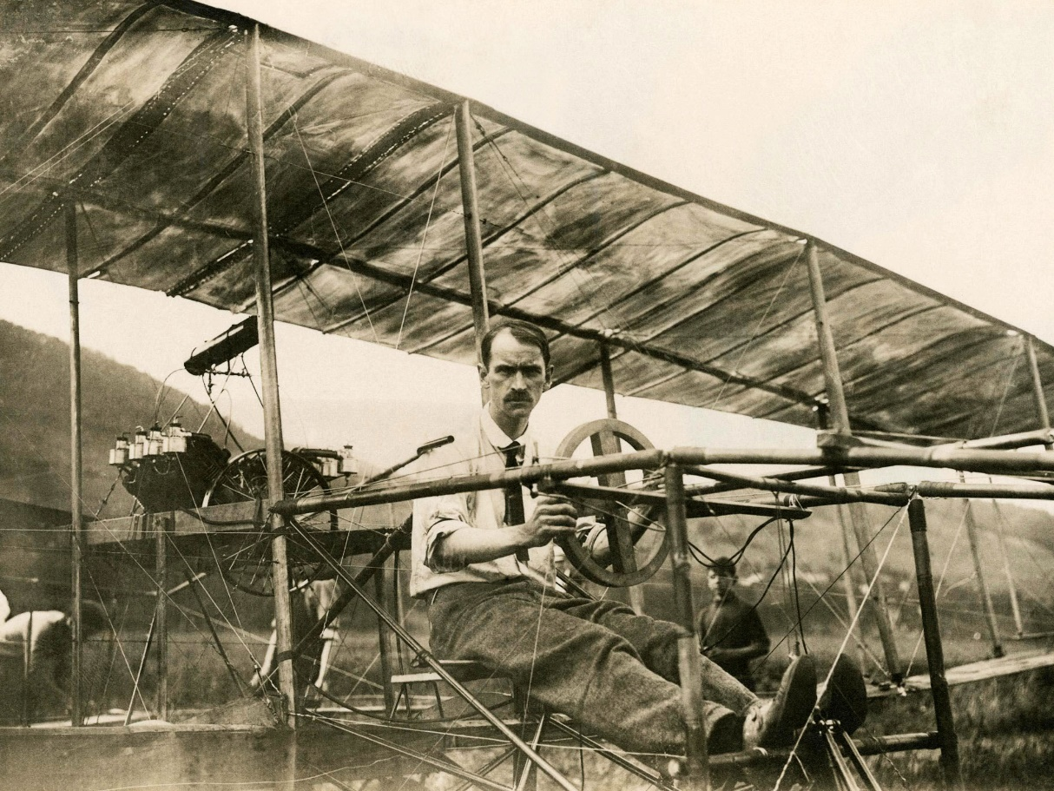
Flight Design Project

Slide 2
Objective
To design a device to travel as far as possible in the air using only the materials provided
Best flight ever:
https://www.youtube.com/watch?v=BV6EP9bBbac
As William Lidell stated in the The Universal Principles of Design:
The best designers sometimes disregard the principles of design.

Slide 3
Practice Objective (4 mins)
Meet your team members and learn their names
Submit a team name that will be used for the duration of the project

Slide 4
Practice Objective analysis
Does everyone know everyone’s name (quiz a random team member)
What process did you follow to pick a name?
Does everyone like the name? If not, what does that mean for your process?
Did everyone get a chance to contribute ideas?
Was this process effective?

Slide 5
“Spray”Brainstorm-3 minutes
Name as many things as possible that fly through the air.
“To have a great idea, have a lot of them.”–Thomas Edison

Slide 6
Google Project Aristotle
Google’s People Operations (HR) conducted a massive study to try and figure out to make the perfect team-Project Aristotle
Very difficult, because they aren’t clear indicators for what type of groups will succeed-group dynamics are extremely complex
Found two important similarities among successful groups:
Equality in distribution of conversational turn taking
Demonstrate high social sensitivity-can figure out how people are feeling

Slide 7
Main Objective Parameters
Groups are randomly assigned
Can only use physical materials provided
Can use internet for 10 consecutive minutes (on one computer) of design time ONLY, group must decide when and alert teacher
Each team can only fly ONE design
Each team gets five launches, longest launch counts
You can use the launchers or throw your design
You will have approximately 90 minutes of design time.

Slide 8
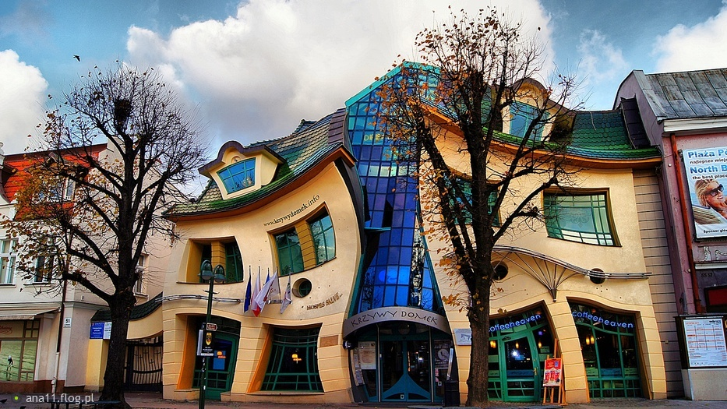
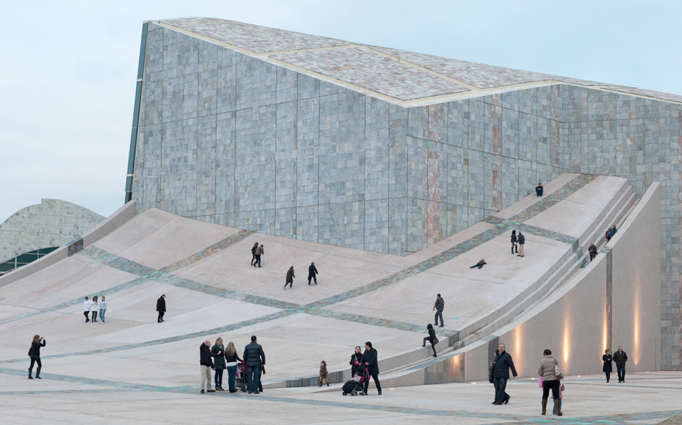
Design Time

Slide 9
Day 1 reflection
How did my group work together?
How can we work more effectively tomorrow?
What were my strengths and weaknesses as a member of my team?
Did I practice the design principle “bias to action?”

Slide 10
Stanford Design Thinking Process

Slide 11
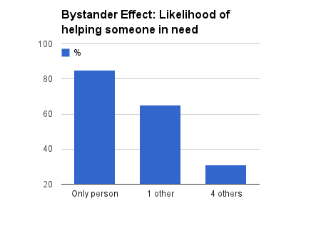
Why use a design process? Bystander Effect
https://www.youtube.com/watch?v=KE5YwN4NW5o
A social psychological phenomenon in which individuals do not offer means of help to a victim when other people are present. The probability of help is inversely related to the number of participants. There is a diffusion of responsibility in groups.
Kitty Genovese
How does this relate to group work?

Slide 12
Why use a design process? Group Think
A psychological phenomenon that occurs within a group of people, in which the desire for harmony of conformity of the group results in an irrational or dysfunctional decision-making outcome. Groups members try to minimize conflict and reach consensus without critical evaluation of alternative viewpoints
Example: Pearl Harbor-overwhelming evidence, including intercepted Japanese communications that an attack was coming in the Pacific Ocean (Pearl Harbor was warned, but the warning was collectively dismissed), were ignored and the US fleet was destroyed

Slide 14
Stanford Design Thinking Process
EMPATHIZE: Work to fully understand the experience of the user for whom you are designing. Do this through observation, interaction, and immersing yourself in their experiences.
DEFINE: Process and synthesize the findings from your empathy work in order to form a user point of view that you will address with your design.
IDEATE: Explore a wide variety of possible solutions through generating a large quantity of diverse possible solutions, allowing you to step beyond the obvious and explore a range of ideas.
PROTOTYPE: Transform your ideas into a physical form so that you can experience and interact with them and, in the process, learn and develop more empathy.
TEST: Try out high-resolution products and use observations and feedback to refine prototypes, learn more about the user, and refine your original point of view.

Slide 15
Design Time

Slide 16
Launch!

Slide 17
Day 2 Individual Reflection
How did my device do? Am I happy with the result?
How did my group function compared to yesterday?
Looking back, how would I approach this problem knowing what you now know?
Did we follow the Stanford Design Process? Why or why not?

Slide 18
Group Dynamic Analysis
What was your groups’ process?
Did you follow the Stanford Design Process? Do you think it has value?
Did your group function effectively?
If you were going to do this again tomorrow, how would you change your process?
What techniques did or could improve the successful functioning of your group?

Slide 19
Process

Slide 20
Share out results
Pick one group member to share: 1-2 minutes each

Slide 21
Design Principle-Bias Toward Action
Bias toward action is a core mindset or principle of design thinking. It means we promote action-oriented behavior, rather than discussion-based work
Action is viewed as a way to get “unstuck,” to inspire new thinking, and to come to agreement as a group

